Slide 1
INSTITUTO DE ENGENHARIA
DIVISÃO TÉCNICA DE GEOTECNIA
FUNDAÇÃO EM SOLO LATERITICO: SEGURANÇA, ECONOMIA, RAPIDEZ
E MEIO AMBIENTE
Prof. Eng. Luciano Décourt
Março / 2023

Slide 2
Capítulo I
Identificação de solos lateríticos e alguns conceitos importantes, mas frequentemente ignorados

Slide 3
Identificação de solos lateríticos
Sondagens SPT / SPT-T
- Cores: vermelha, amarela e cinza
- Presença de concreções de limonita

Slide 4
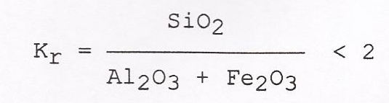
Composição Química
Quimicamente falando, o solo é considerado laterítico se o índice K_{r} é menor que 2:
Mas, na prática da engenharia, essa definição é de muito pouca utilidade. Eu mesmo, nunca a utilizei.

Slide 5
O ensaio MCT
Nogami e Villibor (1981) propuseram um método que é considerado o mais indicado para a classificação dos solos tropicais.
Trata-se de procedimento de referência para essa classificação e consequentemente, para a identificação dos solos lateríticos

Slide 6
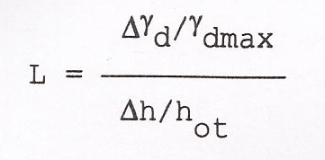
Índice de Ignatius (1992)
Ignatius (1992) propôs um método muito simples para identificação de solos lateríticos, que se baseia na inclinação do ramo seco da curva do ensaio Proctor Normal:
Para L ≥ 0,3, o solo é considerado laterítico.

Slide 7
Ensaios SPT/SPT-T
e
Ensaios Cross Hole

Slide 8
Barros (1992 e 1997), Barros and Pinto (1997) analysed the relationships between G₀ (MPa) and N_{SPT}, for lateritic (LS) and non lateritic soils (NLS), showing that they were quite different.
For lateritic soils (LS):G₀ (MPa) = 56 + 20.3N₇₂
For non lateritic soils (NLS): 7N₇₂ ≤ G₀ (MPa) ≤ 8N₇₂
In most cases, following Barros and Pinto (1997), the identification of lateritic clays might be well established. However, in some other cases it is not so evident.

Slide 9
“THE MECHANICAL AGING OF SOILS”
25th Terzaghi Lecture
John H. Schmertmann
L. Décourt (1989) observed that the Bazaraa (1967) correlations, based on field data, if adjusted by an aging factor of 0.4–0.6 would approximatelly match the SPT vs. relative density correlations previously obtained by Gibbs and Holtz (1957) and Marcuson and Bieganouski (1977).
The writer believes that the above aging explanation helps greatly to explain a big mistery – namely why the Bazaraa correlations did not fit well with the others.

Slide 10
A MORE RATIONAL UTILIZATION
OF SOME OLD IN SITU TESTS
DÉCOURT, L.
FIRST INTERNATIONAL CONFERENCE
ON SITE CHARACTERIZATION – ISC
ATLANTA, U.S.A., 1998

Slide 11
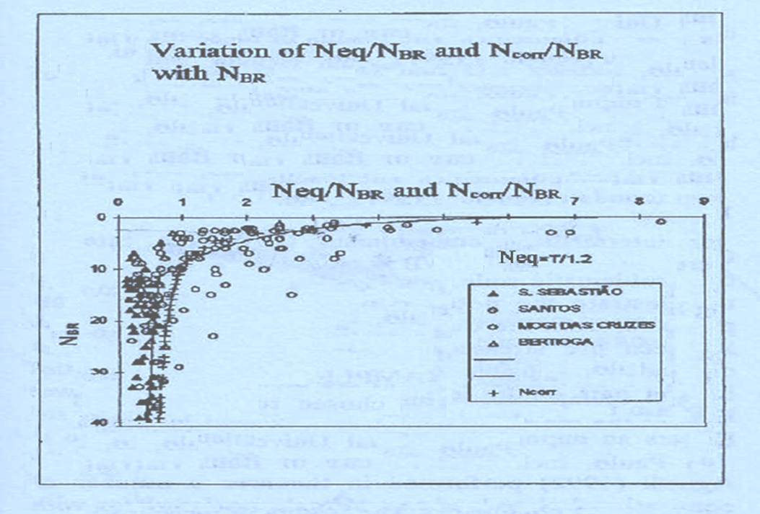

Slide 12
E_{i}≈45-50%
E_{i}≈72%
Corrections to measured N_{SPT}values, in fine Corrections to measured N_{SPT}values, in fine
fine sands below the water level (E_{i}≈45-50%) sands below the water level (E_{i}≈72%)

Slide 13
In some cases, like the mentioned in Décourt (1986) these unrealistic low N_{SPT} values were the most likely explanation for the fact that the capacities of displacement piles, computed using Décourt and Quaresma method (1978; 1982) were much lower than those provided by loading tests. Once the low N_{SPT} values were corrected as suggested in slide10,
the differences between predicted and measured capacities become negligible.

Slide 14
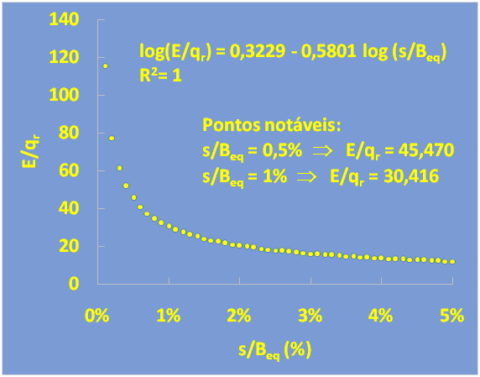

Slide 15
Capítulo II
Fundações diretas
A falácia das teorias de capacidade de carga

Slide 16
THE Texas A&M prediction event
A very important prediction event was held in 1994, at the campus of Texas A&M University.
The main organizers of this event were the ex President of the ISSMGE, Professor Jean Louis Briaud and Mr. Robert Gibbens.
Load tests on five footings were carried out. All footings were square, with widths of 1.0m; 1.5m; 2.5m and 3.0m (2 footings).

Slide 17
QUESTIONS
Two questions were asked by the organizers.
I – What would the stresses for a settlement of 25mm be?
II – What would the stresses for a settlement of 150.0mm be?
The first question was related to the concept of allowable stress.
The second question was related to the concept of bearing capacity.
The organizers considered predictions to be correct in the range of plus or minus 20% of the measured values.

Slide 18
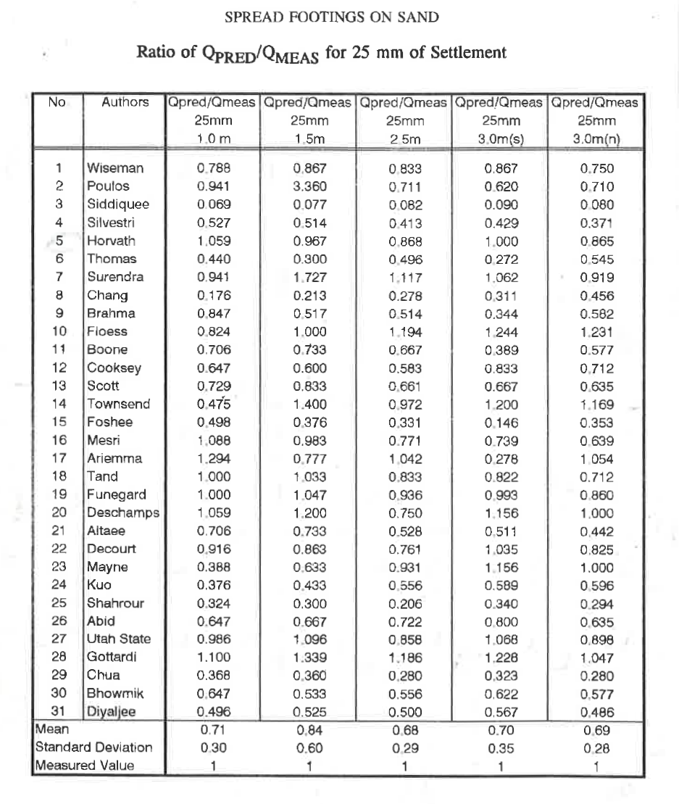

Slide 19
PREDICTIONS
A total of 31 predictions were received from 8 different countries, half from consultants and half from academics. The main conclusion reached from comparing the predictions and the measurements was that nobody gave a complete set of answers consistently falling within ± 20% of the measured values. At the time, the author had not yet developed the method of settlement predictions that he broadly uses nowadays.
The author’s predictions were based on the values of the maximum shear modulus G₀ and their correlations with results of cone penetration tests, CPT and other in situ tests. This procedure was quite laborious.

Slide 20
Anyway the ratios of the predicted stresses to the measures ones were 0.916; 0.863; 0.761; 1.035 and 0.825 with an average of 0.88.
Therefore, four out of five predictions were in the range of ± 20% of the measured values.
The question “II”, related to the bearing capacity demonstrated clearly the incapacity of the author to correctly predict the bearing capacity of footings on sand.

Slide 21
For 25mm, these ratios didn’t show any tendency of variation with the foundation width. An average value of 0.724 was computed. For 150mm settlement these ratios increased linearly with the width of the footings.
A statistical correlation can be established.
Q_{pred}/Q_{meas} = 0.457 + 0.215B
R² = 0.986
Therefore, the errors increase in direct proportion to the width of the footings.

Slide 22
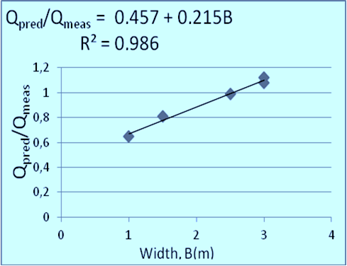
Variation of Q_{pred}/Q_{meas} with B
This means that averages (for the 31 predictors) of the ratio Q_{pred}/Q_{meas} of the footing increased directly with the increase in the footing width, figure above.
It seems that all predictors believed that, for sands, the bearing capacity increased linearly with the footing width.

Slide 23
The load test results present a clear evidence that the stresses corresponding to the bearing capacity does not increase with the footing size.
Therefore the reality was quite different from that the predictors assumed.
Some months later, Décourt, (1994) proposed a new method for predicting the full stress-settlement curve. This new method, Décourt (1994-1999) was developed after a deep analysis of these loading test results.
The method uses a normalized stress-settlement curve.

Slide 24
FUNDAÇÕES E INTERAÇÃO
SOLO- ESTRUTURA
DÉCOURT, L.
X COBRAMSEF
RELATO GERAL
FOZ DO IGUAÇU, BRASIL , 1994

Slide 25
log (q/q_{r}) = 0,426 + 0,426 log (s/B_{eq})

Slide 26
BEARING CAPACITY OF
LONG FOOTINGS, q_{u}
TERZAGHI
q_{u} = cN_{c} + qN_{q} + 1/2γBNγ

Slide 27
SOME OPINIONS REGARDING
THE VALIDITY OF THE BEARING
CAPACITY THEORIES FOR SANDS

Slide 28

BRIAUD AND JEANJEAN (1994)
“If is a constant and independent of B, then N_{γ}, cannot be a constant and must carry a scale effect in 1/B.
This major shortcoming plus the difficulty in obtaining an accurate value of the needed soil parameter Ø and the documented poor accuracy of this method (Amar et al. 1984) lead to the recommendation that:
- The use of this equation should be discontinued”.

Slide 29
DÉCOURT (1999)
“What has been done in the past 60 years was adequate, but, only for that time.
On the threshold of the 21st century, however, it is mandatory that we clear our minds of some concepts that helped for a while, but now prevent any further development of the art of designing foundations.
It is being proposed that design approaches

Slide 30
based on these concepts be abandoned.
Emphasis has to be given to settlements.
Foundation designs in the 21st century, other than for displacement piles, should rely exclusively on settlement computations, leaving the ghosts of bearing capacity theories and failures to the past, duly exorcised and buried, to show up never more”.

Slide 31
FELLENIUS, B.H. (1999)
“It is amazing that the arbitrary nature of the calculated N-factors has not long ago sent the formula to the place where it belongs – the museum of old paradigms whose time has passed. However, the bearing capacity is so well entrenched that stating that it is wrong and should not be used would seem to border or committing heresy. When I now say so, should I fear being burned at the stake, or is the practice ready to accept new views ?”

Slide 32
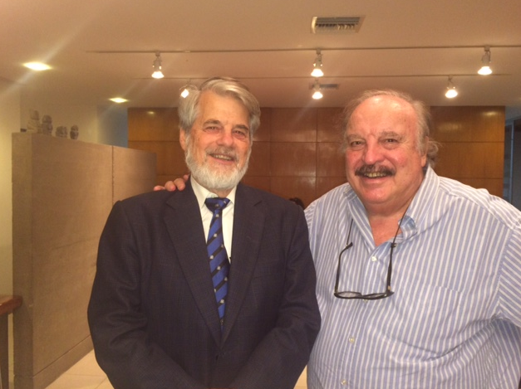

Slide 33
POULOS, H.G. (2010)
“Unfortunately, there is now considerable evidence that demonstrates that this theoretical conclusion is not confirmed in practice.
Décourt (2008) has re-plotted data from tests on footings of various sizes and found that, when normalized with respect to settlement/diameter (s/b), the load-settlement curves are unique and not dependent on the footing size nor on the relative density.

Slide 34
Similar conclusions have been reached from recent centrifuge test carried out on model footings by Gavin et al (2009).
Akbas and Kulhawy (2009) have arrived to conclusions similar to those of Décourt and Gavin et al”.

Slide 35
PREDICTION OF LOAD SETTLEMENT RELATIONSHIPS FOR FOUNDATIONS ON THE BASIS OF THE SPT-T
DÉCOURT, L.
CYCLE OF INTERNATIONAL
CONFERENCES LEONARDO ZEEVAERT
MEXICO, 1995

Slide 36
ASSESSMENT OF THE REFERENCE STRESS, q_{r} ON BASIS OF N_{SPT}, N_{eq} AND T, FOR COMMON SOILS
Soil type I……………sands
Soils type II………….intermediate soils
Soils type III………...saturated clays (Ø_{u}= zero)

Slide 37
SOLO | q_{r} (kPa) | q_{r} (kgf/cm²) | q_{r} (kPa) | q_{r} (kgf/cm²)
I | 95N₆₀/95T | 0,95N₆₀/0,95T | 114N₇₂/114N_{eq} | 1,14 N₇₂/1,14N_{eq}
II | 80N₆₀/80T | 0,80N₆₀/0,80T | 96N₇₂/9,6N_{eq} | 0,96 N₇₂/0,96N_{eq}
III | 65N₆₀/65T | 0,65N₆₀/0,65T | 78N₇₂/7,8N_{eq} | 0,78 N₇₂/0,78N_{eq}

Slide 38
ASSESSMENT OF THE REFERENCE STRESS, q_{r} ON BASIS OF N_{SPT}, N_{eq} AND T, FOR LATERITIC SOILS
For the practicing foundation engineer, what matters is that lateritic soils (LS) are much stiffer than non lateritic soils (NLS).
The extraordinary stiffness characteristics of lateritic clays have been ignored by foundation engineers. Décourt (1994) showed, for the first time, that lateritic clays are much stiffer than non lateritic clays with equal SPT values.

Slide 39
O procedimento proposto para a avaliação de q_{r} com base no N_{SPT} não é aplicável para todos os solos. Para solos saprolíticos, o método dá resultados confiáveis, desde que se use valores de N_{eq} em lugar dos valores de N_{SPT}.
Entretanto, para solos lateríticos, o fator de majoração α_{L}, que leva em conta os benefícios da laterização, tem que ser considerado.
Com base em experiência anterior, sugere-se valores de α_{L} entre 2,0 e 3,0, a serem confirmados através de provas de carga

Slide 40
BEHAVIOR OF FOUNDATIONS UNDER WORKING LOAD CONDITIONS
DÉCOURT, L.
XI PAMCSMGE
FOZ DE IGUAÇU, BRAZIL, 1999

Slide 41
DÉCOURT PROPOSALS (1999)
log (q/q_{r}) = C + C log (s/B_{eq})
or
log (q/q_{r}) = C (1 + log s/B_{eq})
“C” is approximately constant for a given type of mineral. For quartz sands, either sedimentary or residual, the values of “C” are in the range 0.40 ± 15% and for calcareous sands in the range 0.70 ± 15%.
.

Slide 42
FELLENIUS PROPOSALS (1999)
q/q_{r} = (s/s_{r})^{e}
The reference parameters q_{r} and s_{r} are the same used in Décourt’s method.
The Fellenius “e” value is identical to the Décourt “C” value. The range of the proposed “e” values varies between 0.5 and 0.9, which is approximately, the same range proposed by Décourt (1999), for calcareous sands.
This is by no means surprising because Fellenius´s analysis was based on load tests carried out in calcareous sands.

Slide 43
UNICIDADE DA CURVA NORMALIZADA CARGA (TENSÃO) - RECALQUE
Em 1999, afirmei que a curva tensão-recalque, normalizada, era única, não dependendo da densidade da areia, do tamanho da sapata e de sua profundidade.
As tensões foram normalizadas pela tensão de referência, q_{r}, que é a tensão que corresponde a um recalque de 10% do lado de uma sapata quadrada e o recalque, pela largura da sapata (ou diâmetro da estaca).
Todas as análises procedidas desde então, confirmaram essa assertiva.

Slide 44
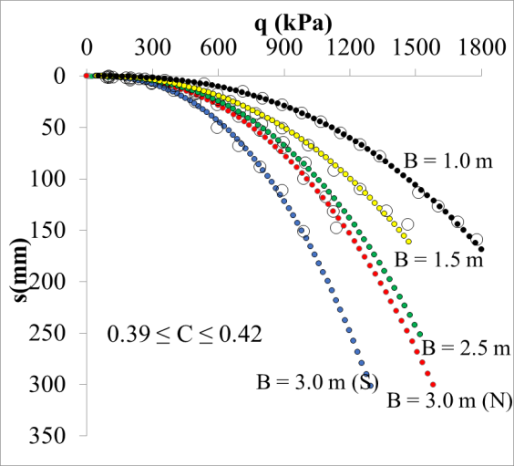
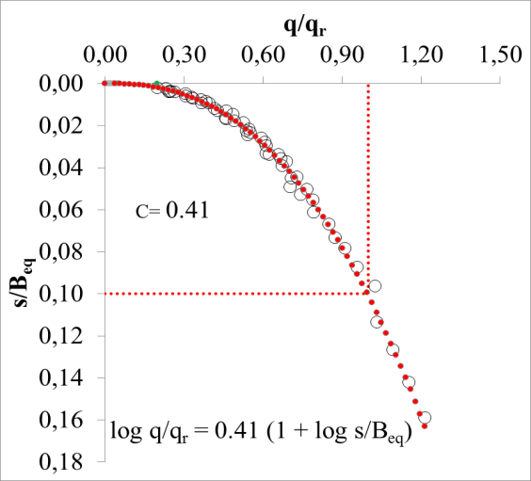
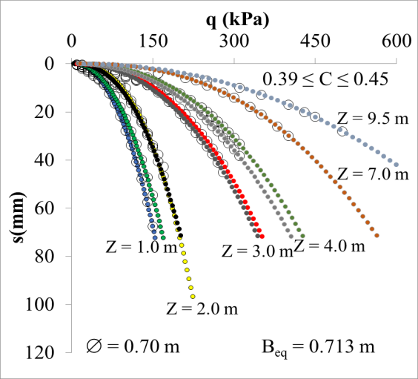
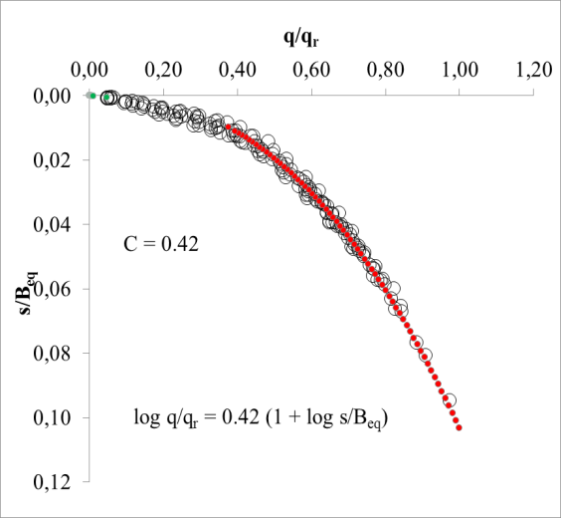
Fundamentos do método proposto e algumas evidências de sua correção
Conforme
medições
Normalizada
Curvas tensão-recalque para sapatas quadradas de diferentes dimensões. ASCE, GSP 41, 1994, Briaud, J.L. e Gibbens, R.M.
Normalizada
Curvas tensão-recalque para sapatas em uma areia laterítica à diferentes profundidades. Agnelli, N. (1992), Bauru, SP.

Slide 45
O MÉTODO RDZ
Contrariamente ao procedimento usual para dimensionamento de fundações que objetiva a obtenção de uma tensão admissível, o Método RDZ objetiva a obtenção de recalques diferenciais zero, entre todas as sapatas. Como consequência óbvia, as tensões a serem aplicadas ao solo pelas sapatas terão que ser diferentes.
É muito importante salientar que os “imputs” a serem utilizados são aqueles fornecidos por ensaios de rotina, SPT, SPT-T e CPT.

Slide 46
Capítulo III
Fundações profundas

Slide 47
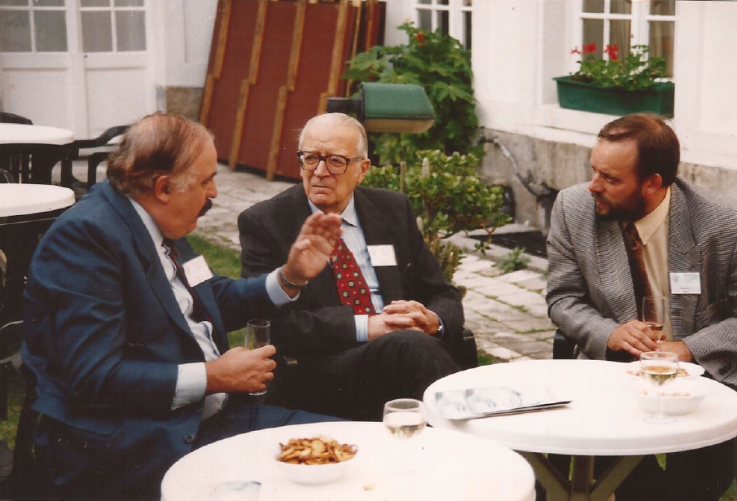
Com o Prof. Fernando Lizzi, criador da Estaca Raiz

Slide 48
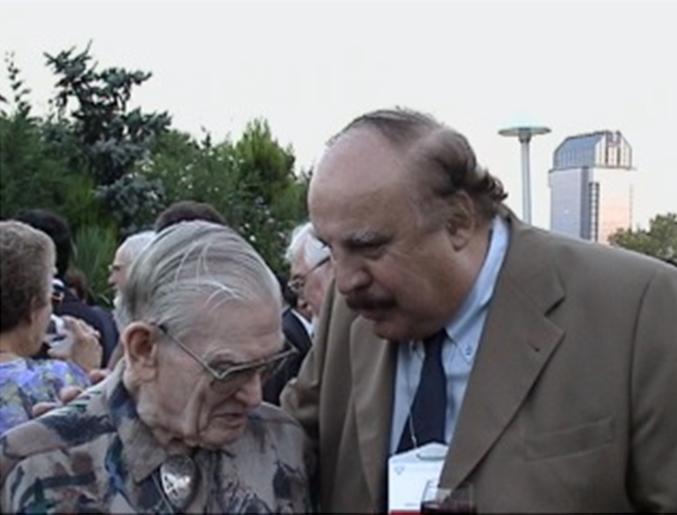
Com o Prof. Ralph Peck

Slide 49
Dimensionamento de
fundações profundas em
solos lateríticos com base
nos ensaios SPT/SPT-T

Slide 50
Fórmula Décourt e Quaresma
+ Coeficientes de Majoração
α_{L} e ᵝ_{L}
Com base na experiência do autor:
2,00 ≤ α_{L} ≤ 3,00
2,00 ≤ ᵝ_{L} ≤ 3,00
Valores a serem confirmados através de provas de carga

Slide 51
Valores propostos por outros autores, para a correção do método de Décourt e Quaresma, no caso de solos lateríticos
Autores | Coeficiente de majoração.... ᵝ_{L}
Fabris et al., 2004 | ≈ 5,00
Abreu et al., 2015 | 1,74 ≤ ᵝ_{L} ≤ 6,25
Polido et al., 2016 | 2,50 ≤ ᵝ_{L} ≤ 3,70

Slide 52
SAPATAS ESTAQUEADAS (ESTACAS-T)
O método Décourt é usado não apenas para fundações diretas. Ele também é usado para projetos de sapatas estaqueadas (Estacas–T).
Tipicamente, uma estaca (ou mais) é colocada sob a sapata no centro da coluna e sua capacidade de carga é calculada. Para a estaca, sua capacidade é admitida como sendo totalmente desenvolvida para o deslocamentos do seu topo, de 15mm.
O procedimento proposto é o de simplesmente subtrair da carga nominal da coluna o valor de 80% do correspondente à capacidade calculadada da estaca e prosseguir com o projeto, como se tratasse de uma simples sapata, com essa carga reduzida.

Slide 53
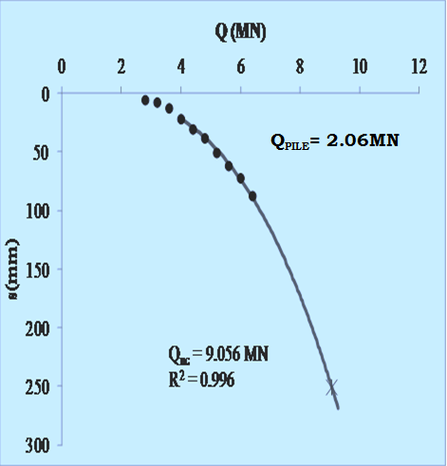
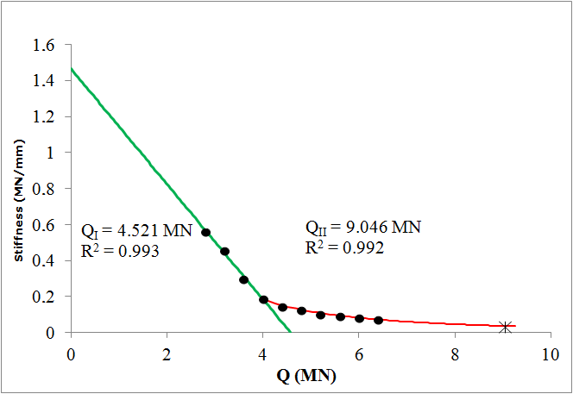
PROVA DE CARGA EM
SAPATA ESTAQUEADA
The Stiffness Plot for the Piled-Footing
Load-settlement curve for the Piled-Footing

Slide 54
Capítulo IV
Nossos 3 campos experimentais de fundações:
Edifício Rimini.........................................1992
Hospital São José (Beneficência).........1999
Edifício Carmel........................................2013

Slide 55
A GÊNESE
1992...quando tudo começou
Edifício Rimini

Slide 56
The Behavior of a Building with Shallow Foundations on a Stiff Lateritic Clay
Luciano Décourt
Vertical and Horizontal Deformations of Foundations and Enbankments, ASCE, GSP 40, 1994. Texas, U.S.A.

Slide 57
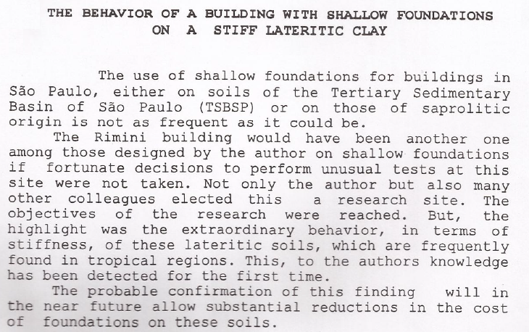

Slide 58
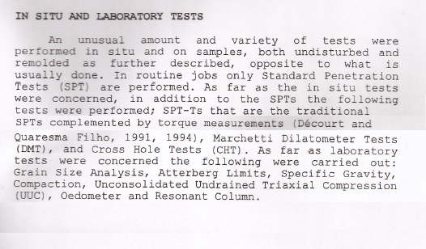

Slide 59
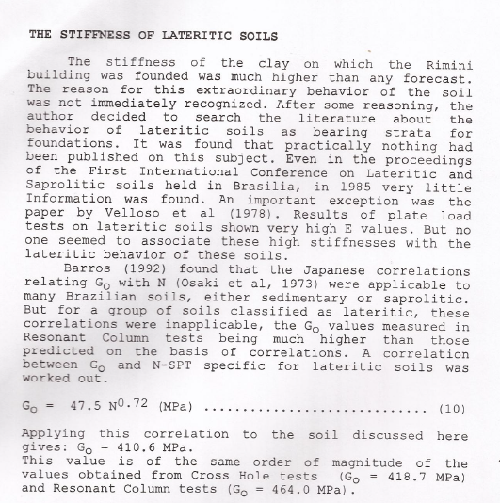

Slide 60
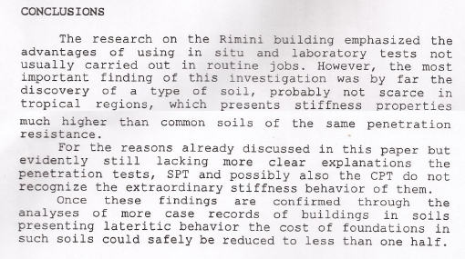

Slide 61
Fundações em solos lateríticos
Hospital da Beneficência Portuguesa
Relatório de Apreciação Geral
Luciano Décourt
São Paulo, Outubro / 2001

Slide 62
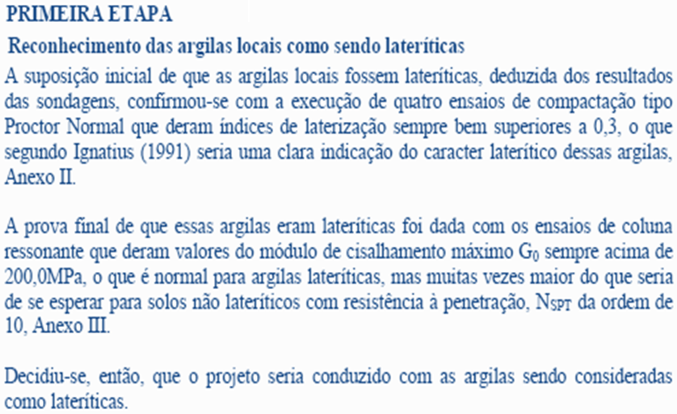

Slide 63
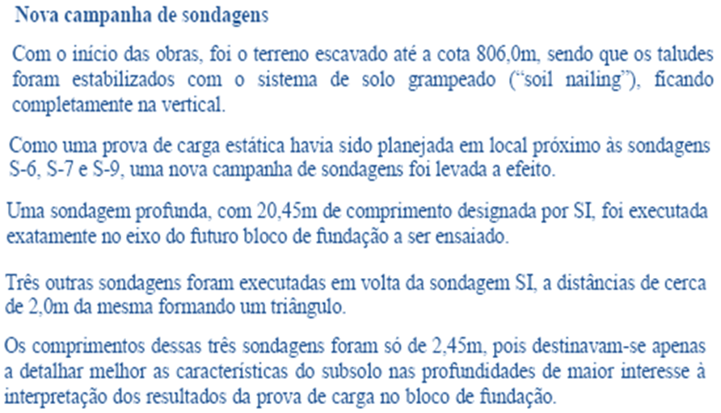
.

Slide 64

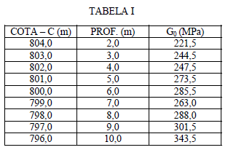
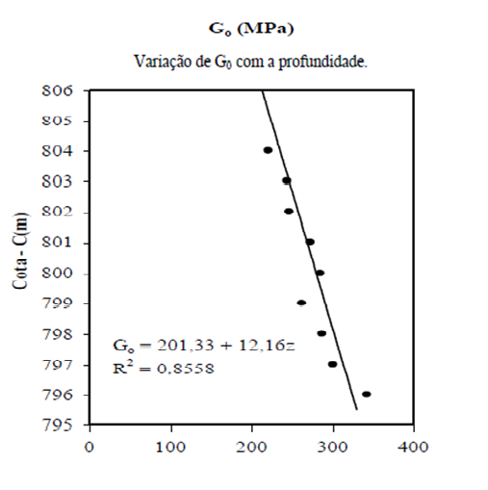

Slide 65
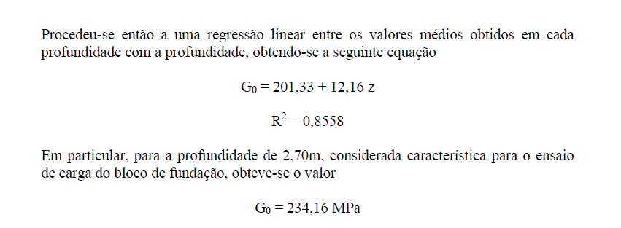

Slide 66
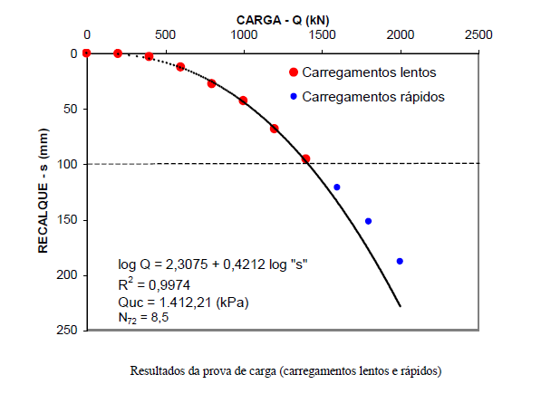

Slide 67
Avaliação da tensão de referência
ou
de ruptura convencional, q_{r}
Décourt (2018)
q_{r} (G₀) = 0,006 G₀ = 0,006 x 234,16 = 1,405MPa
q_{r} (PC) = 1,412MPa

Slide 68
Condomínio
Edifício Carmel
2013

Slide 69
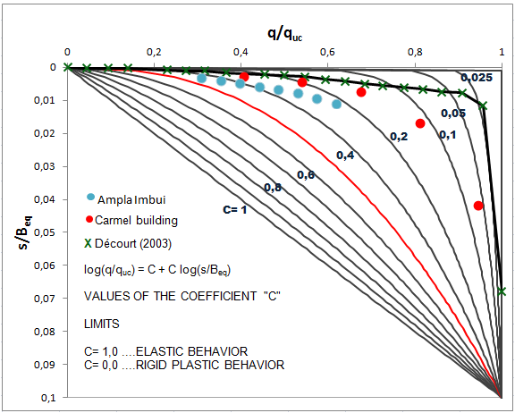

Slide 70
Capítulo V
Outras três importantes obras:
- Edifício Transatlântico
- São Carlos Condominium, Fortaleza
- Condomínio Edifício One, Fortaleza

Slide 71
Construtora Romeu Chap Chap.....1994
Rua 13 de Maio (região da av. Paulista)
Prova de carga
Fundação mista (Estaca T)
Solo tipo III (argila laterítica)
N_{SPT} ou N_{eq.......}14,4
d = 500,00mm
B_{eq} = 1800,00mm

Slide 72




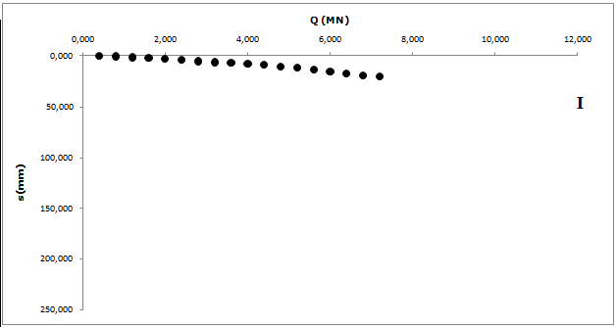
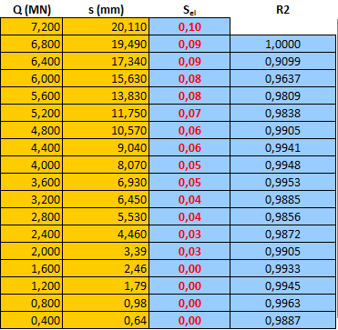

Slide 73
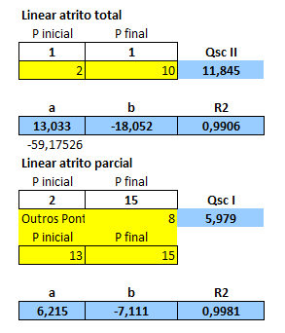
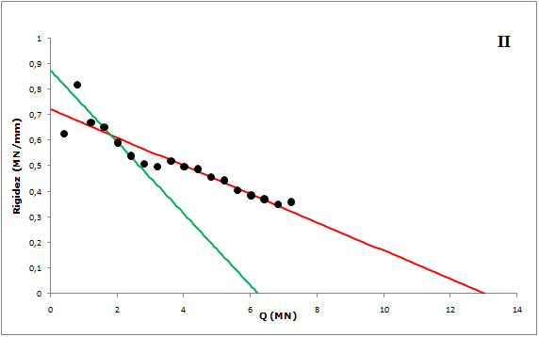

Slide 74
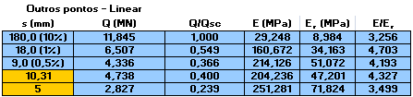
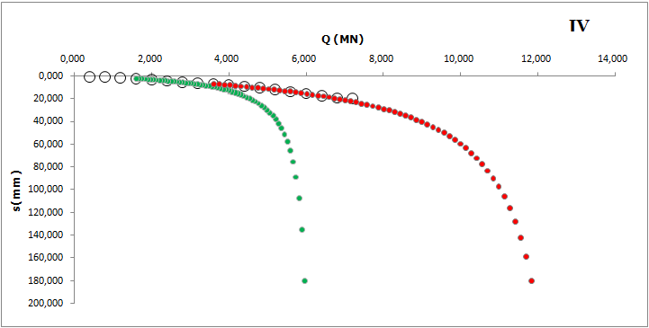

Slide 75
Projeto de Fundações da
Obra São Carlos Condominium
Fortaleza, Ceará
Trabalho submetido à premiação:
Prêmio José Machado
ABMS

Slide 76
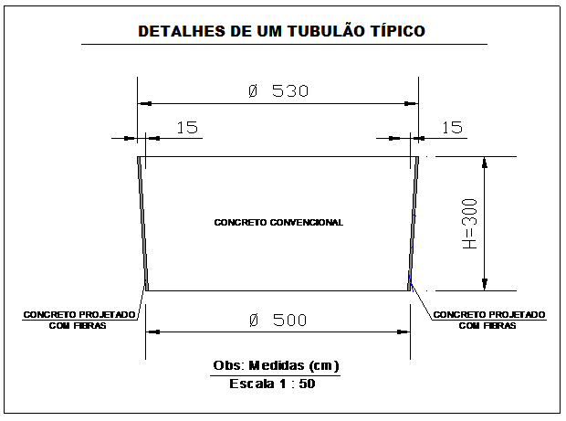
Recomendações executivas

Slide 77
ENSAIOS CROSS-HOLE E DOWN-HOLE
Considerando-se agora apenas a profundidade de 15,0m, ponta das estacas, ou seja, das provas de carga, ter-se-ia:
- SCH-01................ V_{s} = 740,0m/s.....................Cross-Hole
- SCH-01................ V_{s} = 768,0m/s.....................Down-Hole
- SCH-06................ V_{s} = 704,0m/s.....................Cross-Hole
- SCH-06................ V_{s} = 713,0m/s......................Down-Hole
A média desses 4 valores é 731,25m/s.

Slide 78
O valor médio de G₀ é de 1.123 (MPa).
Comparando-se os valores médios de G₀ para profundidades entre 10,0 e 15,0m, com o correspondente à profundidade de 15,0m, obter-se-á um valor cerca de 10% superior.
Como as tensões de referência q_{rc}, que correspondem a uma deformação de 10% do diâmetro da fundação, são proporcionais a G₀, conclui-se que a 15,0m de profundidade obtém-se uma resistência cerca de 10% inferior à resistência média entre 10,0m e 15,0m.

Slide 79
Resultados das Provas de Carga
PILAR | Q_{uc} (tf) | Q_{sc} (tf) 1º carreg. | Q_{sc} (tf) 2º carreg. | Q_{sc} (tf) Média 1º e 2º carregs.
P-1 | 695,3 | 464,57 | 414,50 | 439,54
P-6 | 714,4 | 315,29 | 368,90 | 342,10
P-10 | 769,5 | 361,37 | 346,60 | 353,99
MÉDIA | 726,4 | 380,41 | 376,67 | 378,54
P-2 | 460,13 | - | 293,96 | -

Slide 80
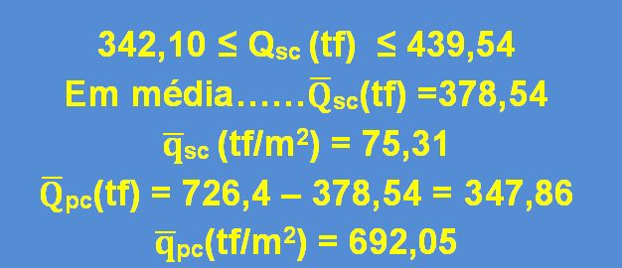

Slide 81
Avaliação da tensão de referência ou de ruptura convencional, q_{r}
_{Décourt, 2018}
q_{r} (G₀) = 0,006 G₀ = 0,006 x 1.123 = 6,735MPa
q_{r} (PC) = 6,921 MPa

Slide 82
Programa de Acompanhamento de Recalques
Programa de Correção das
Medidas de Recalque

Slide 83
SIMULATED LOADING TESTS ON BASIS OF SETTLEMENT MEASUREMENTS
A couple of years ago, I developed a method for turning conventional settlement measurements into full scale loading tests. The program not only simulates load test results, but also determines the, eventually unknown, settlement values, at the date the measurements began. Besides, it makes a statistical adjustment of the measured values. The next slide below shows the results of one of these tests. In this particular case, the settlement measurements began when the column loads were about 2/3 of their nominal values.

Slide 84
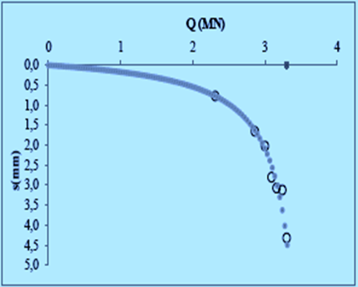
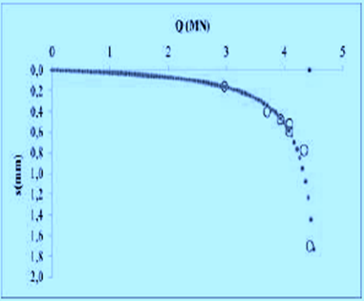
Corrected load-settlement curves

Slide 90
2ª VICTOR DE MELLO LECTURE
“THE DE MELLO FOUNDATION ENGINEERING LEGACY”
Professor Harry G. Poulos
CONGRESSO LUSO-BRASILEIRO DE GEOTECNIA, ABMS, 2010
GRAMADO, RS

Slide 91
The ultimate shaft friction developed by piles within a piled raft can be significantly greater than that for a single pile or a pile in a conventional pile group. This is because of the increased normal stresses generated between the soil and the pile shaft by the loading on the raft. The results obtained by Katzenbach et al (1998) indicate that the piles within the piled raft foundation develop more than twice the shaft resistance of a single isolated pile or a pile within a normal pile group, with the centre piles showing the largest values.
THUS, THE USUAL DESIGN PROCEDURES FOR A PILED RAFT, WHICH ASSUME THAT THE ULTIMATE PILE CAPACITY IS THE SAME AS THAT FOR AN ISOLATED PILE, WILL TEND TO BE CONSERVATIVE, AND THE ULTIMATE CAPACITY OF THE PILED RAFT FOUNDATION SYSTEM WILL BE GREATER THAN THAT ASSUMED IN DESIGN.

Slide 94
R | Q_{E} (tf)
1,941 | 233,49
2,413 | 185,84
2,016 | 190,885
1,752 | 154,02
2,067 | 260,91
1,604 | 242,7
1,604 | 222
1,563 | 249,29
1,564 | 184,41
1,52 | 115,371

Slide 95
Capítulo VI
A Maturidade
2018...O estado da arte
“Design of Shallow Foundations on Soils and Rocks on Basis of Settlement Considerations”

Slide 96

GSP 299, ASCE (2018)

Slide 97
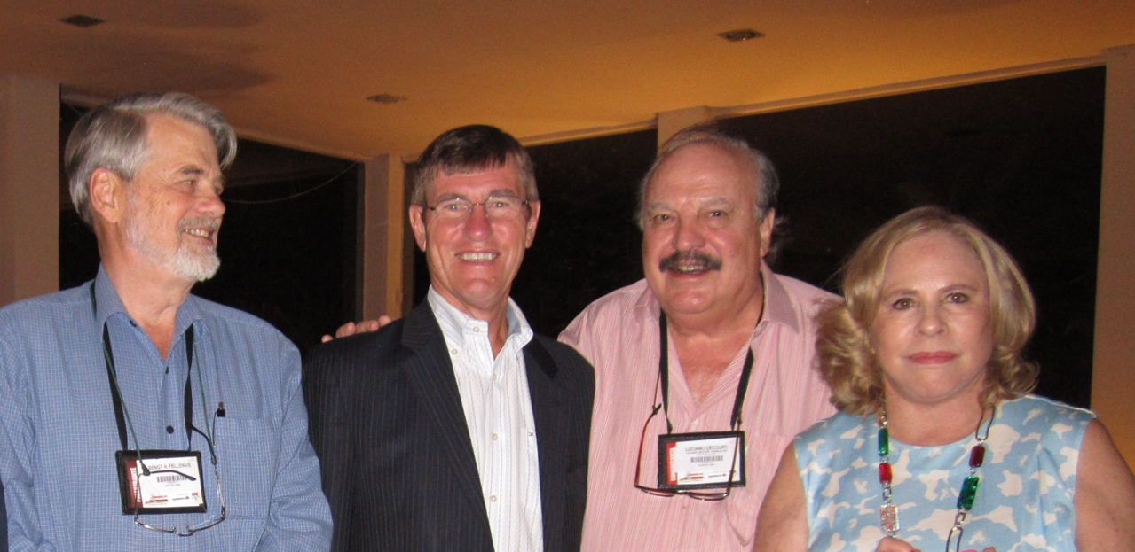
Prof. Bengt Fellenius
Prof. Jean-Louis Briaud
Ex-Presidente da ISSMGE e
atual Presidente da ASCE
Prof. Luciano Décourt
Ex-Vice Presidente
da ISSMGE
Sra. Beth Décourt

Slide 98
Design of shallow foundations on soils and rocks on basis of settlement considerations
(L. Décourt, 2018)
In modern foundation engineering, emphasis is given to settlement, rather than to bearing capacity, Décourt (1999), Fellenius (1999).
In Brazil, as in many other countries, the Standard Penetration Test, SPT is, by far, the most used in situ test. The efficiency of the Brazilian SPT is about 72% and its penetration resistance is designated, as N₇₂. A very important improvement of this test was introduced by Décourt and Quaresma Filho (1991, 1994), the SPT-T.

Slide 99
Initial considerations:
Briaud and Jeanjean (1994) observed that, in a stress-settlement plot, upon normalizing the settlements by the footing widths, all stress-settlement curves merge into a single one.
Décourt (1994b), generalized the procedure proposed by Briaud and Jeanjean (1994). Besides normalizing settlements, as proposed by these authors, the stresses were also normalized by the reference stress, q_{r} which is the stress corresponding to a settlement of 10% of the width of a square footing:
log (q/q_{r}) = 0.426 + 0.426 (log s/B_{eq})

Slide 100
Décourt (1999) analysed the results of 145 loading tests in very different types of soils, from all over the world. It was proposed to change the constant value of 0.426, Décourt (1994b), by a coefficient “C”, called Coefficient of Intrinsic Compressibility, function of the type of mineral constituting the grains.
log (q/q_{r}) = C + C log (s/B_{eq})
or
log (q/q_{r}) = C (1 + log s/B_{eq})

Slide 101
For computing footing settlements, Fellenius (1999) proposed a similar procedure:
q/q_{r} = (s/s_{r})^{e}
The reference parameters q_{r} and s_{r} are the same used in Décourt’s method.
The Fellenius “e” value is identical to the Décourt “C” value. The range of “e” values proposed by Fellenius (1999) varies between 0.5 and 0.9, which is approximately, the same range proposed by Décourt (1999), for calcareous sands.

Slide 102
Assessment of the reference stress, q_{r} on basis of N_{SPT} and T for lateritic soils (LS)
The formely proposed procedure for assessing q_{r} on basis of N_{SPT} values is not applicable to structured soils. As already pointed out, for saprolites, the method gives reliable results, provided N_{eq} values are used instead of N_{SPT} values.
For lateritic clays, however, an increasing factor, α_{L} for taking into account the benefits of laterization, has to be used. On basis of our previous experience, values of αL between 2.0 and 3.0 are suggested. But, only loading tests can provide a definitive answer.

Slide 103
“C” is approximately constant for a given type of mineral. For quartz sands, either sedimentary or residual, the values of “C” are in the range 0.40 ± 15%, being C=0.42 a good estimate for most of the cases and for calcareous sands in the range 0.70 ± 15%.
For lateritic soils (LS), “C” values are in the range 0.21 to 0.45.
More precise values, however, are only obtained analysing loading test results.
In the absence of these tests, values of “C” between 0.28 and 0.42 are suggested for lateritic clays.

Slide 104
A new proposal for assessing q_{r} for lateritic (LS) and non lateritic soils (NLS)
Very recently a new approach started to be analyzed. Correlations between q_{r} and Go are being searched for. However, the available data are still scarce and almost limited to lateritic clays.
Based on this restricted number of cases, it is postulated that for lateritic (LS) and non lateritic soils (NLS) q_{r} and Go, are related as follows:
q_{r} ≈ 0,006Go.....LS (clays)
0,010G0 ≤ q_{r} ≤ 0,015Go....NLS (clays and sands)
This new proposal, bypasses the major problem of considering lateritic, a clay that might not be lateritic, thus leading to a non conservative design.On the contrary, using such correlations, if the supposed lateritic clay was not lateritic, and the above formula for lateritic clays was used in design, the computed value of the reference stress, q_{r}, would be much smaller than the actual one.

Slide 105
Capítulo VII
Dissertações de mestrado sobre o tema fundações
em solos lateríticos

Slide 106
Estudo do Método de Décourt
(2019) para Dimensionamento
Geotécnico de Fundações em
Prédios Altos em Solos Lateriticos
da Formação Barreiras: Eficiência
Econômica e Ambiental.
Aluno: Eng. Sandro Moreira Braga
Instituto Federal do Ceará
Orientador: Prof. Marcos Fábio Porto de Aguiar
Coorientador: Prof. Luciano Décourt
Fundações em Solos Lateríticos
Aluno: Alan Henrique C. Brito
Pontíficia Univ. Católica – RJ
Orientador: Prof. Alessandro Cirone
Coorientador: Prof. Luciano Décourt

Slide 107
Capítulo VIII
Meio ambiente

Slide 108
Pesquisa revela enorme variabilidade nos indicadores de impacto ambiental de concretos usinados no Brasil e oportunidade de mitigação
Fábio Pedroso,
Jornalista no Instituto Brasileiro do Concreto (IBRACON), Editor da Revista CONCRETO & Construções Administrador e redator do Blog CONCRETO

Slide 109
O concreto usado na construção civil é o segundo produto mais consumido no mundo, atrás apenas da água. Produzir concreto requer a extração de britas e areias, a fabricação de cimentos e outros produtos industriais, o transporte desses materiais e o consumo de água. A produção e transporte das matérias-primas utilizadas na fabricação do concreto, são responsáveis por emissões de gases e poluentes para a atmosfera, a água e o solo.

Slide 110
Os fatores apontados para essas diferenças nos indicadores de impacto ambiental estão relacionados às diferenças nos modos de produção entre as centrais de concreto, bem como às disparidades de composição e produção de cimentos entre seus fabricantes.
Os pesquisadores destacam a importância em se escalar ferramentas de contabilidade ambiental no setor construtivo como estratégia fundamental para mitigar impactos ambientais.

Slide 111
OPORTUNIDADES DE MITIGAÇÃO DE IMPACTOS AMBIENTAIS DO CONCRETO USINADO
O que mais saltou aos olhos dos pesquisadores nos resultados foi a enorme variabilidade nos indicadores de impactos ambientais entre os fabricantes de concreto usinado no país

Slide 112
O potencial de aquecimento global variou de 128 a 348 kg CO₂ eq./m³, ou seja, uma diferença de 220 kg. Este indicador revelou que, a cada metro cúbico do concreto produzido, as emissões de gases do efeito estufa variaram de 128 quilos para 348 quilos de um fornecedor a outro.
Essa variação de 220 quilos nas emissões de dióxido de carbono por metro cúbico deste concreto entre os fabricantes, corresponde a uma diferença de 1,76 toneladas de CO₂ a cada caminhão betoneira com capacidade de 8m^{3.}

Slide 113
Quando a avaliação do ciclo de vida de produtos for exigida dos fabricantes do setor, será possível aos consumidores optar pelos fabricantes com os melhores indicadores de impacto ambiental. Por sua vez, esse processo levará os fabricantes mais dispendiosos do ponto de vista da eficiência ambiental a melhorarem seus processos produtivos, para sobreviverem no mercado, o que contribuiria para mitigar os impactos ambientais em toda cadeia da construção.

Slide 114
Reduzir quase duas toneladas nas emissões de gás carbônico por caminhão betoneira é, sem dúvida, uma medida mitigadora significativa de redução de impacto ambiental do concreto usinado, que cabe às centrais dosadoras brasileiras perseguir.

Slide 115
Capítulo IX - Conclusões
Os solos lateríticos têm suas características de rigidez muitíssimo sub avaliadas pelas sondagens SPT e mesmo pelas SPT-T. Não obstante toda a recente divulgação que tem sido feita nos últimos 30 anos, como por exemplo, a palestra Milton Vargas da ABMS que foi por nós apresentada em dez cidades do Brasil nos meses de novembro e dezembro de 2017, a especialidade, com raras exceções, ainda não tomou conhecimento dessa nova realidade.
A determinação das propriedades de engenharia desse tipo de solo exige a execução de outros ensaios, entre os quais se destaca a determinação das velocidades de propagação das ondas de cisalhamento, através de ensaios Cross-Hole e Down-Hole. Conhecidas essas velocidades e os pesos específicos naturais dos solos, pode-se calcular os módulos de cisalhamento à baixas deformações, conhecidos por G₀.

Slide 116
O conhecimento de G₀ permite a avaliação das características de rigidez desses solos e, a elaboração de projetos de fundações realísticos e confiáveis. Aliás, o professor Harry Poulos, indiscutivelmente um dos maiores engenheiros de fundações do mundo, afirma:
“G₀ is possibly the most fundamental stiffness parameter for a geomaterial”
Mas, a resposta final sobre a capacidade de suporte de qualquer tipo de fundação, em qualquer tipo de solo, somente pode ser obtida através da execução de provas de carga, muito bem projetadas e cuidadosamente executadas. Tudo Isso tem sido feito , de forma rotineira, em nossas obras. As características de rigidez dos solos, são assim determinadas, com elevadíssima confiabilidade. Apesar dessa qualidade dos parâmetros determinados, os valores utilizados no projeto do São Carlos Condominium foram, propositalmente, bastante menores do que os fornecidos pelos ensaios.
,
Notes:
&

Slide 117
Um bom projeto de fundações deve, necessariamente, obedecer ao trinômio SER: Segurança, Economia e Rapidez.
O projeto do São Carlos Condominium é, como vimos, bastante conservador, sendo, pois, o aspecto segurança, plenamente atendido.
Quanto a economia, basta se observar que o custo do estaqueamento foi reduzido a zero e que os volumes de escavação, de concreto e de aço foram inferiores a 50% dos volumes correspondentes aos blocos de coroamento das estacas. Em reais, uma redução de cerca de 3 milhões.
Quanto a rapidez, desnecessário se fazer qualquer tipo de comentário, face a sua obviedade.
Notes:
&

Slide 118
O ensaio SPT é a única ferramenta que a imensa maioria dos engenheiros de fundações utiliza, para a elaboração de projetos de fundações. Trata-se, indiscutivelmente, de um ensaio indispensável para esses estudos, mas é fundamental que se reconheça que esse ensaio não permite que se dimensione fundações, de forma segura e econômica, em qualquer tipo de solo. A utilização exclusiva deste ensaio em solos lateríticos, muito frequentes no nordeste do Brasil e também em diversos locais aqui em São Paulo, irá, fatalmente, conduzir à situações altamente indesejáveis a saber:
– Fundações com grandes dificuldades construtivas e consequentemente, com sérios riscos à integridade da obra;
- Fundações com custos até 3 a 4 vezes maiores do que seriam necessários;
ee´´´´´´´´´´´´´´´´´´´´´´´´´´´´´´´´´´´´´´´´´´´´´´´´´´´´´´´´´´´´´´É

Slide 119
E em correspondência a mim enviada em 03 de abril de 2018, o Prof. Poulos, mencionando as contribuições que ambos temos dado à especialidade, dizia:
“…I am a fan of the use of G_{o} as it reflects the geological imperfections of the rock or soil in-situ, and is possibly the most fundamental, stiffness parameter for a geo-material”.
Finalmente, uma última observação, quanto aos ensaios “Cross Hole”. Por serem pouco utilizados em projetos de fundações, são executados, de forma correta, apenas por um número muito reduzido de empresas, daí a conveniência de serem sempre contratados com bastante antecedência.

Slide 120
Já o professor Harry Poulos, reconhecidamente , um excepcional geotécnico , que, entre outras coisas, projetou as fundações do edifício ‘Burj Khalifa”, em Dubai que , com 828,0m de altura é o mais alto do mundo e também é o autor do mais atualizado livro sobre fundações de edifícios altos, o “Tall Building Foundation Design”, 2017, onde, o meu método de cálculo de capacidade de carga de estacas, com base no SPT é recomendado, considera ser G₀ um parâmetro de extraordinária importância. Porém, a especialidade ainda está longe de reconhecer essa realidade.
Em palestra patrocinada pela abms, proferida há alguns anos, o professor poulos enfatizou que:
“THE MOST CRITICAL DESIGN ISSUE IS GROUND CHARACTERIZATION AND PARAMETER ASSESSMENT¨.
Notes:
&

Slide 121
A razão de se obter fundações com custos muito inferiores aos usuais ,decorre da utilização dos ensaios “Cross Hole, que permitem que se determine o módulo de cisalhamento máximo dos solos , conhecido como G_{0.} Entretanto esses ensaios não são normalmente utilizados pelos engenheiros geotécnicos nos projetos de fundações.
A utilização do módulo de cisalhamento máximo, G₀, permite que sejam reconhecidas algumas notáveis propriedades dos solos, o que os tradicionais ensaios SPT, rotineiramente utilizados, não permitem nem remotamente avaliar.
Não há, pois, nenhuma “mágica” envolvida, apenas a aplicação dos conhecimentos adquiridos nos últimos 30 anos, que tem sido amplamente divulgados e aplicados com muito sucesso em dezenas de obras, realidade essa que a maioria dos engenheiros geotécnicos, ainda insiste em ignorar.

Slide 122
,
É chegada a hora de o empresariado entender que, o pequeno investimento adicional, feito na fase de investigação do solo, não só irá conferir mais segurança à obra, mas também irá retornar centenas de vezes maior. Além disso jamais esquecer seu comprometimento com o meio ambiente. Reduzir quase duas toneladas nas emissões de gás carbônico por caminhão betoneira é, sem dúvida, algo muito significativo.
Notes:
&

Slide 123
Anexos
Fundações diretas em
argilas, areias, solos residuais, solos lateríticos, rochas sãs e alteradas
e............?

Slide 124
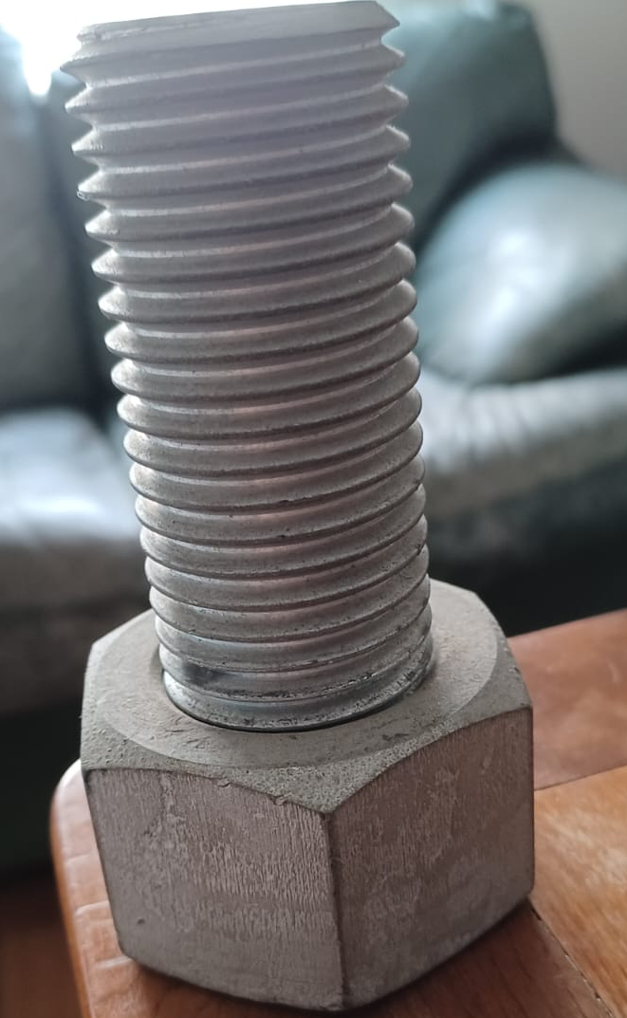
E.......em
A Ç O

Slide 125
Anexo - I
Pesquisa IPT

Slide 127
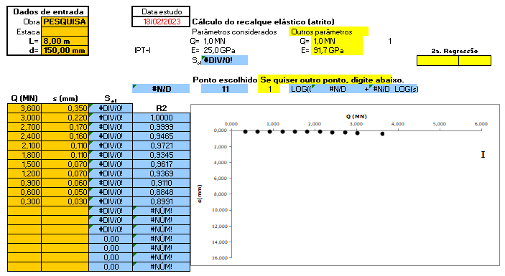

Slide 128
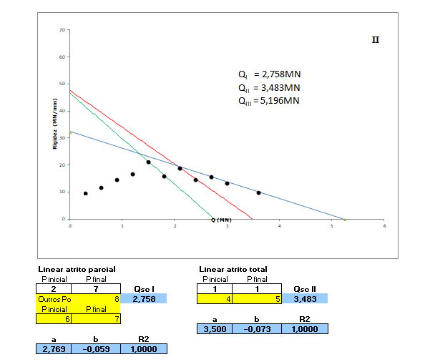

Slide 129
Furo de 15,0cm de diâmetro e barra de Rocsolo de 3”
A_{T} = 176,71cm²
A_{AÇO} = 40,71cm²
A_{concreto} = 136,0cm²
Q_{I} = 2,819 MN...carga de escoamento do aço
Q_{II} = 0,544MN (fck = 40,0 MPa)
Q_{II} = 0,680 MN (fck = 50,0 MPa)
Q_{T} = 3,363MN (fck= 40,0 MPa)
Q_{T} = 3,499MN (fck= 50,0 MPa)
Q_{T} = 3,483MN (Prova de carga)

Slide 130
Anexo II
Prova de Carga
Obra: Colméia Sky

Slide 131
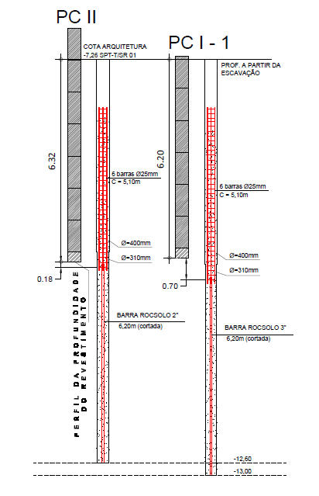

Slide 132
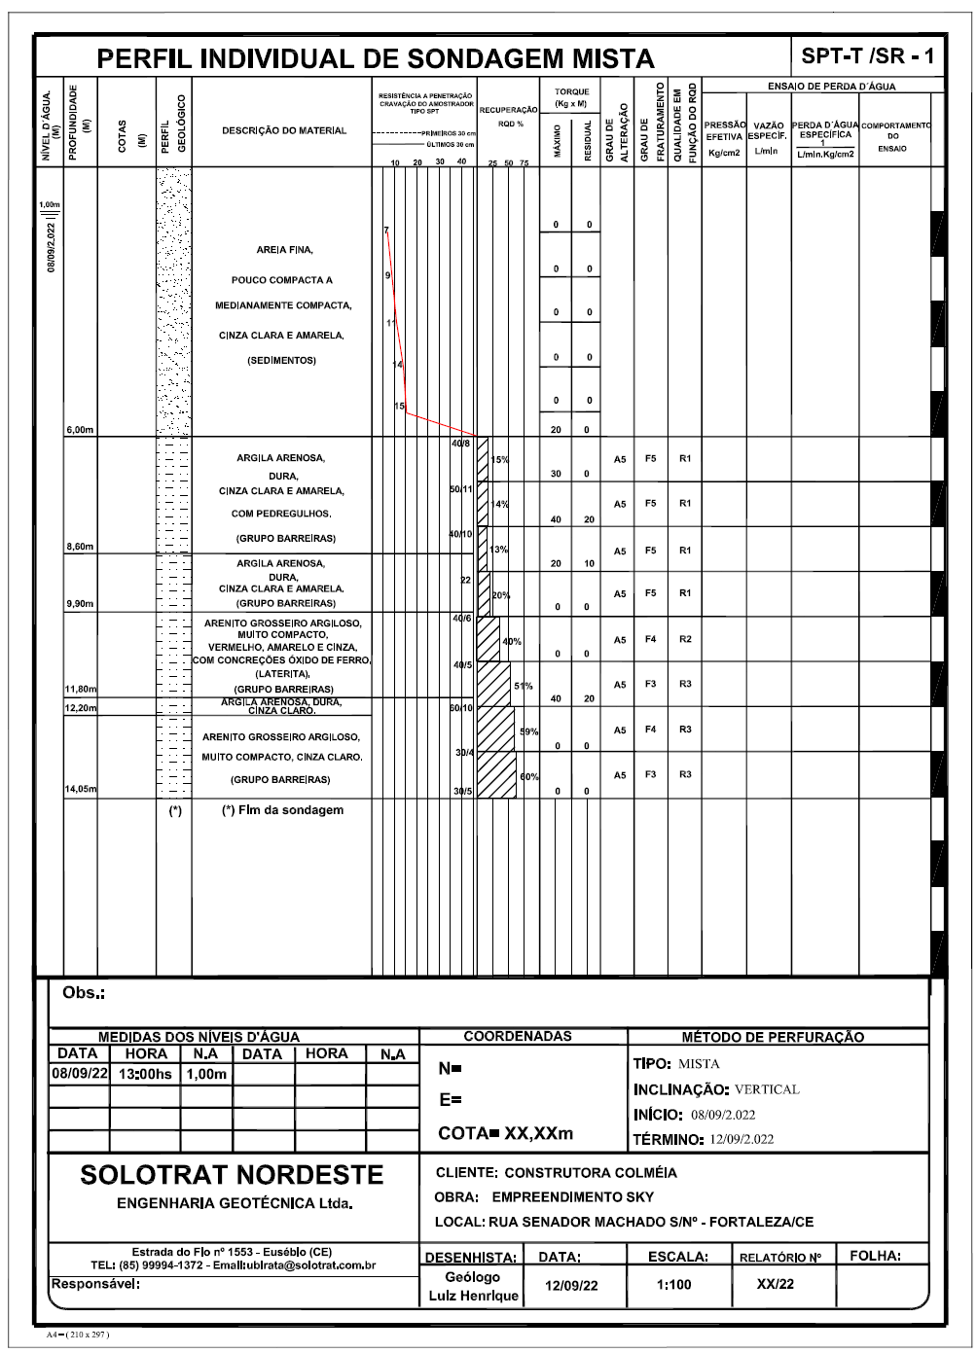

Slide 133
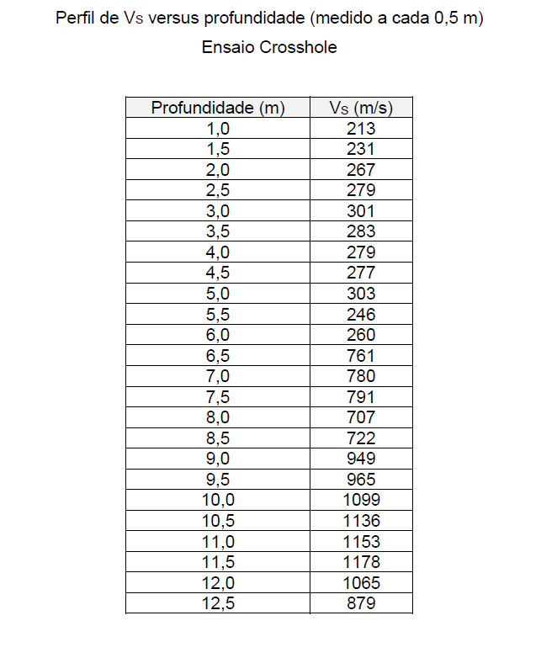

Slide 134
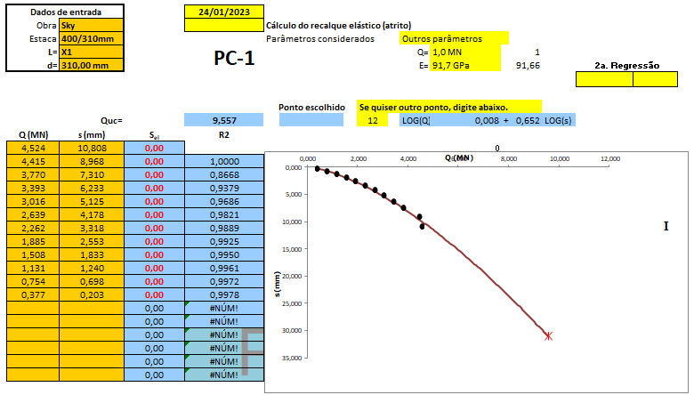

Slide 135
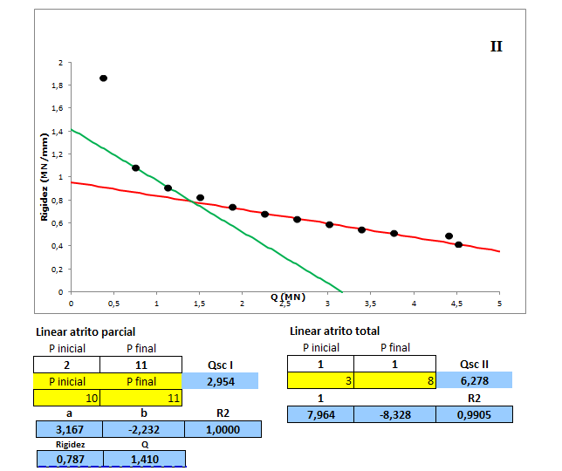

Slide 136
Prova de carga – obra: Colmeia Sky
Estaca Raiz Ø = 310mm - Barra Rocsolo de 3,0”
A_{T} = 754,77cm²
A_{AÇO} = 40,71cm²
ΔA = 714,06cm²
Cálculo
Barra Rocsolo de 3,0”
Q_{I} = 2,819 MN........carga de escoamento do aço
Concreto ou Groute
Q_{II} = 2,856 MN (fck = 40,0MPa)
Q_{II} = 3,570 MN (fck = 50,0MPa)
Q_{T} = 5,675MN (fck= 40,MPa)
Qt =6,389MN (fck= 50,0 MPa)
Prova de carga
Q_{T} = 6,278MN

Slide 137
MUITO OBRIGADO

